Slide 1


Node.js Development
Introduction To The Course
Ivaylo Kenov
Technical Trainer
Software University
https://softuni.bg

Slide 2
Table of Contents
Course Objectives
Course Program
The Trainer
Examination
Learning Resources

Slide 3
Node.js Development
Course Objectives & Program

Slide 4
Node.js Development
First course
HTTP & Web server fundamentals
Vanilla Node.js
Commonly used modules
Development tools
Deployment
Requires basic JavaScript knowledge
Homework, Workshop & Practical Exam

Slide 5
Express.js Development
Second course
Databases
MVC architecture
Express router
Middleware
Authentication & Authorization
Requires Node.js knowledge
Homework, Project, Workshop & Practical Exam

Slide 6
Angular.js Development
Third course
SPA applications
Controllers
Directives
Routes
Filters
Requires Express.js knowledge
Homework, Project, Workshop & Practical Exam

Slide 7
Warning: Not for Absolute Beginners
The "Node.js" course is NOT for absolute beginners
Take the HTML & JavaScript courses at SoftUni first: https://softuni.bg/trainings/1271/web-fundamentals-html-css-november-2015 https://softuni.bg/trainings/1295/javascript-basics-january-2016
This course is OK for beginners, but requires previous coding skills
Requirements
HTML & JS (ES 2016) coding skills – entry level
Computer English – entry level

Slide 8
The Trainer
Who Am I?

Slide 9

The Trainer
Ivaylo Kenov
Various job titles at the same time:
Mathematical competitions champion
Full Stack Technical Trainer
Senior Software Developer
Solutions Architect & Technical Lead
Owner of a Software Company
{Insert Jot Title Here}
Contacts
https://github.com/ivaylokenov
https://facebook.com/ivaylo.kenov
https://linkedin.com/in/kenov

Slide 10
Evaluation
Criteria

Slide 11
Scoring System for “Node.js Development"
Practical Exam – 100%
Bonuses
Up to 10%
Homework + evaluation – 5%
Forum bonuses – 5%

Slide 12
JS Frameworks – Practical Exam
Practical exam
Develop vanilla Node.js web server
Various responses
Deploy the application
Your project should be written in Node.js
Your project should correctly follow principles of high-quality-code

Slide 13
Homework Assignments
Doing your homework is very important!
Programming can only be learned through a lot of practice!
You should write code every day!
Each lecture is followed by a few exercises
Try to solve them in class
The rest are your homework
Homework assignments are due in 1 week after each lecture
Submission will be accepted through our web site: softuni.bg

Slide 14
Homework Peer Reviews
Give feedback to a few random homework submissions
Students submit homework anonymously
Please exclude your name from the submissions!
For each homework submitted
Students evaluate 3 random homeworks
From the same topic, after the deadline
Give written feedback, at least 200 characters
Low-quality feedback → report for punishment
Everyone will get feedback for their homework

Slide 15
Resources
What We Need Additionally

Slide 16
Course Web Site & Forums
The JavaScript Frameworks official web site:
Check the "Software University Forum":
Discuss the course exercises with your colleagues
Find solutions for all course exercises
Share source code / discuss ideas / help each other
https://softuni.bg/trainings/1434/node-js-development-september-2016
https://softuni.bg/forum

Slide 17
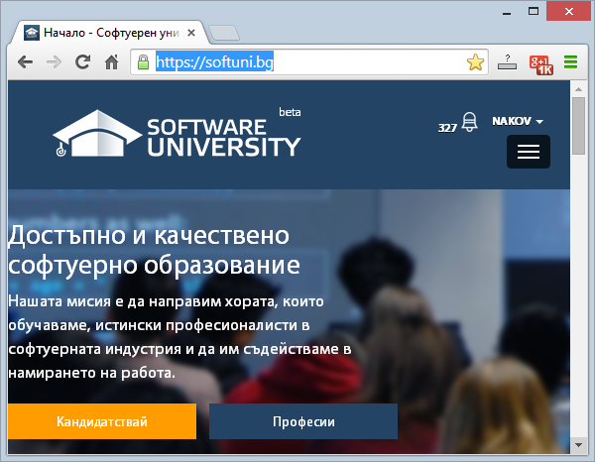
Software University Learning System (SULS)
Software University Learning System (SULS)
www.softuni.bg
Important resource for students
Homework submissions
Homework check-up
Exams and results
Reports about your progress
…

Slide 18
Node.js Resources
https://nodejs.org/en/
https://nodejs.org/en/docs/
https://blog.risingstack.com/how-to-become-a-better-node-js-developer-in-2016/
https://github.com/feross/standard
https://www.codementor.io/nodejs/tutorial/nodejs-best-practices

Slide 19
Recommended Software
Node.js 6.5.0 or later
IDE of your choice
Visual Studio Code - https://code.visualstudio.com/docs/runtimes/nodejs
Sublime Text
Atom
Microsoft Visual Studio 2015 + Node.js Tools
WebStorm
…

Slide 20








JavaScript Frameworks – Node.js Development
https://softuni.bg/courses/javascript-frameworks

Slide 21
License
This course (slides, examples, demos, videos, homework, etc.) is licensed under the "Creative Commons Attribution-NonCommercial-ShareAlike 4.0 International" license
Attribution: this work may contain portions from
"End-to-end JavaScript Applications" course by Telerik Academy under CC-BY-NC-SA license

Slide 22




Free Trainings @ Software University
Software University Foundation – softuni.org
Software University – High-Quality Education, Profession and Job for Software Developers
softuni.bg
Software University @ Facebook
facebook.com/SoftwareUniversity
Software University @ YouTube
youtube.com/SoftwareUniversity
Software University Forums – forum.softuni.bg

